Slide 1
Week-4
4.3.7 Fast Ethernet
5.2

Slide 2
What leads to fast Ethernet?
To pump up the speed, various industry groups proposed two new ring based optical LANs.
One was called FDDI and the other was called fiber channel.
Both of them failed for desktop, management was complicated, complex chips and very expensive

Slide 3
Ethernet
Physical Media :-
10 Base5 - Thick Co-axial Cable with Bus Topology
10 Base2 - Thin Co-axial Cable with Bus Topology
10 BaseT - UTP Cat 3/5 with Tree Topology
10 BaseFL - Multimode/Singlemode Fiber with Tree
Topology
Maximum Segment Length
10 Base5 - 500 m with at most 4 repeaters (Use Bridge to extend the network)
10 Base2 - 185 m with at most 4 repeaters (Use Bridge to extend the network)
10 BaseT - 100 m with at most 4 hubs (Use Switch to extend the network)

Slide 4
Fast Ethernet
100 Mbps bandwidth
Uses same CSMA/CD media access protocol and packet format as in Ethernet.
100BaseTX (UTP) and 100BaseFX (Fiber) standards
Physical media :-
100 BaseTX - UTP Cat 5e
100 BaseFX - Multimode / Singlemode Fiber
Full Duplex/Half Duplex operations.

Slide 5
Fast Ethernet
Provision for Auto-Negotiation of media speed: 10 Mbps or 100Mbps (popularly available for copper media only).
Maximum Segment Length
100 Base TX - 100 m
100 Base FX - 2 Km (Multimode Fiber)
100 Base FX - 20 km (Singlemode Fiber)

Slide 6
Gigabit Ethernet
1 Gbps bandwidth.
Uses same CSMA/CD media access protocol as in Ethernet and is backward compatible (10/100/100 modules are available).
1000BaseT (UTP), 1000BaseSX (Multimode Fiber) and 1000BaseLX (Multimode/Singlemode Fiber) standards.
Maximum Segment Length
1000 Base T - 100m (Cat 5e/6)
1000 Base SX - 275 m (Multimode Fiber)
1000 Base LX - 512 m (Multimode Fiber)
1000 Base LX - 20 Km (Singlemode Fiber)
1000 Base LH - 80 Km (Singlemode Fiber)

Slide 7
Routing Algorithm
Part of N/L
Decides 2 things:
Which i/p pkt to transmit?
Where/Which o/p line to select?
Session routing: for the whole session no need to change the output line selected by 1st packet
In general routers have 2 phase:
Forwarding
Table updating

Slide 8
Non-adaptive & adaptive algorithm
Routing algorithm can be grouped into:
Non-adaptive algorithms (fixed traffic light)
do not base their routing decisions on measurements or estimates of the current traffic and topology.
Instead, the choice of the route to use to get from I to J (for all I and J)is computed in advance, off-line, and downloaded to the routers when the network is booted.
This procedure is sometimes called static routing.

Slide 9
Adaptive algorithms
change their routing decisions to reflect changes in the topology, and usually the traffic as well.
Adaptive algorithms differ in where they get their
information (e.g., locally, from adjacent routers, or from all routers),
when they change the routes (e.g., every ∆T sec, when the load changes or when the topology changes), and
What metric is used for optimization (e.g., distance, number of hops, or estimated transit time).

Slide 10
The Optimality Principle
the optimality principle and the sink tree provide a benchmark against which other routing algorithms can be measured.
a general statement about optimal routes without regard to network topology or traffic
It states that if router J is on the optimal path from router I to router K, then the optimal path from J to K also falls along the same route.

Slide 11
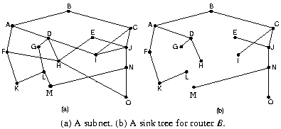
Where the distance metric is the number of hops.
Sink tree is not necessarily unique; other trees with the same path lengths may exist.
The goal of all routing algorithms is to discover and use the sink trees for all routers.

Slide 12
Design Goals of Routing Algorithms
Algorithm Types
Routing Metrics
Dynamic Routing Algorithms

Slide 13
Algorithm types
Static Vs Dynamic
Single Path Vs Multiple Path
Host Intelligent Vs Router Intelligent
Intradomain Vs Interdomain

Slide 14
Routing Metrics
Path Length
Reliability
Delay
Bandwidth
Load
Communication cost

Slide 15
Static Algorithms
Shortest Path Algorithm
Flooding
Flow based Routing
Dynamic Algorithms
Distance Vector Routing
Link State Routing
Hierarchical Routing

Slide 16
Shortest Path Routing (a non-adaptive routing algorithm)
Given a network topology and a set of weights describing the cost to send data across each link in the network
Find the shortest path from a specified source to all other destinations in the network.
Shortest path algorithm first developed by E. W. Dijkstra

Slide 17
Mark the source node as permanent.
Designate the source node as the working node.
Set the tentative distance to all other nodes to infinity.
While some nodes are not marked permanent
Compute the tentative distance from the source to all nodes adjacent to the working node. If this is shorter than the current tentative distance replace the tentative distance of the destination and record the label of the working node there.
Examine ALL tentatively labeled nodes in the graph. Select the node with the smallest value and make it the new working node. Designate the node permanent.

Slide 18
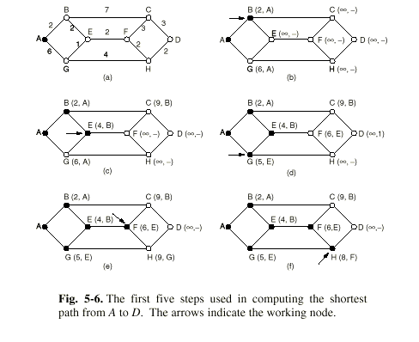
Example of Shortest Path Routing

Slide 19
Flooding (a nonadaptive routing algorithm)
Brute force routing
Every incoming packet is sent on every outgoing line
Always finds the shortest path quickly
Also finds many long paths
Time to live is set to size of subnet
Selective Flooding
Flood only in the direction of the destination
Practical in a few settings
Military Applications
Distributed Databases
Metric for comparison

Slide 20
Distance Vector Routing (an adaptive routing algorithm)
Bellman-Ford Routing
Ford Fulkerson Algorithm
Original ARPANET routing algorithm
Previously used on Internet (RIP)
Early version of DecNet and Novell’s IPX
AppleTalk and Cisco routers use improved versions of this algorithm

Slide 21
Distance Vector Routing (an adaptive routing algorithm)
Neighboring routers periodically exchange information from their routing tables.
Routers replace routes in their own routing tables anytime that neighbors have found better routes.
Information provided from neighbors
Outgoing line used for destination
Estimate of time or distance
can be number of hops, time delay, packet queue length, etc.

Slide 22
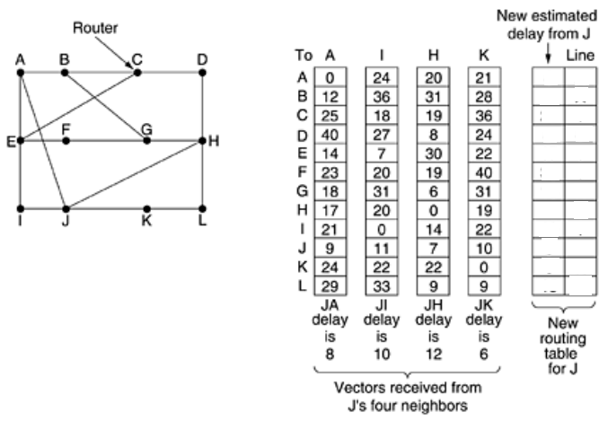
Distance Vector Routing (an adaptive routing algorithm)

Slide 23
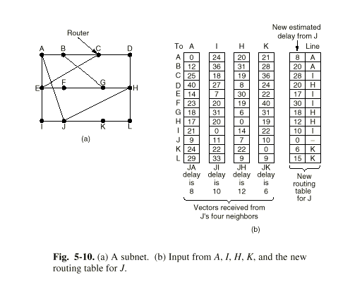
Distance Vector Routing (an adaptive routing algorithm)

Slide 24
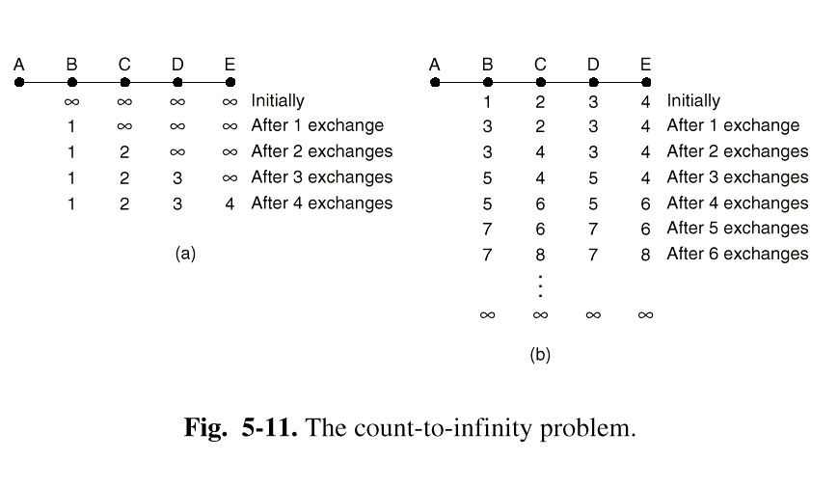
The Count to Infinity Problem

Slide 25
Link State Routing (an adaptive routing algorithm)
Five Steps
1.) Discover your neighbors and learn their addresses.
2.) Measure the cost (delay) to each neighbor.
3.) Construct a packet containing all this information
4.) Send this packet to all other routers.
5.) Compute the shortest path to every other router.
1.) Discovering Your Neighbors
Send “Hello” packet on each point-to-point line. Destination node replies with its address.

Slide 26
2.) Measuring Line Cost
Send an “ECHO” packet over the line.
Destination is required to respond to “ECHO” packet immediately.
Measure the time required for this operation.
Question: Should we measure just the time it takes to transmit the packet, or should we include the time that the packet waits in the queue?

Slide 27
Argument 2:
We should include the time that the packet spends in the queue, as this provides a more accurate picture of the real delays.
We should only include the transmission times, otherwise the network is likely to oscillate between preferred paths.

Slide 28
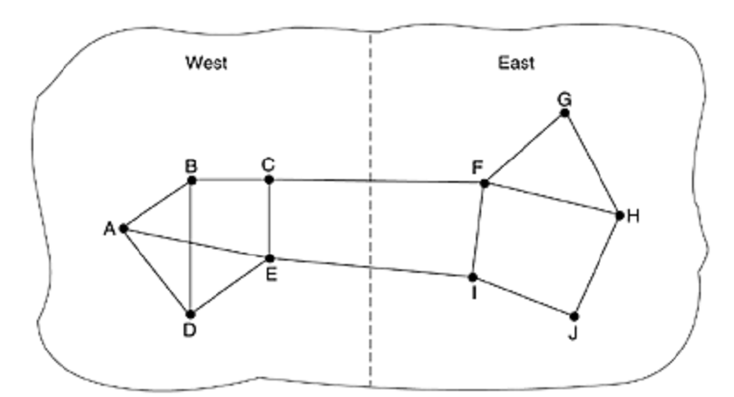

Slide 29
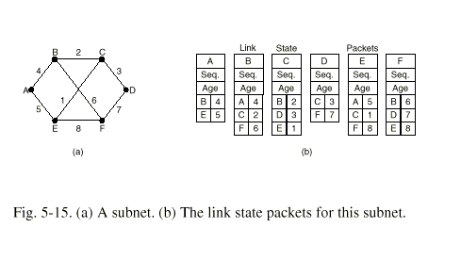
Build Link State Packets
Building the link state packets is easy.
when to build? 1) periodically, and
2) when some significant event occurs,

Slide 30
Distributing the Link State Packets
Use selective flooding
Sequence numbers prevent duplicate packets from being propagated
Lower sequence numbers are rejected as obsolete
Computing the New Routes
Dijkstra’s Shortest Path algorithm is used to determine the shortest path to each destination.

Slide 31
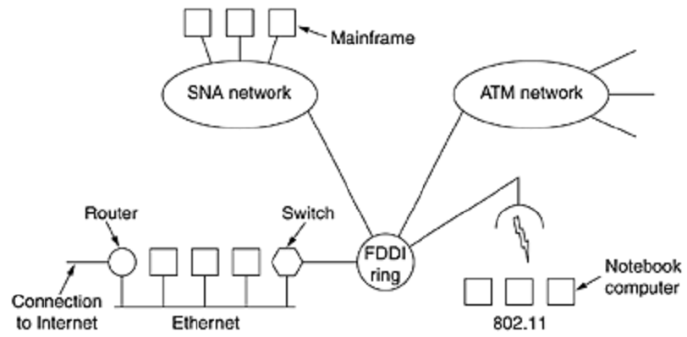
Internetworking
More networks are connected to form internet

Slide 32
The purpose of interconnecting all these networks is to allow users on any of them to Communicate with users on all the other ones and also to allow users on any of them to access data on any of them.

Slide 33
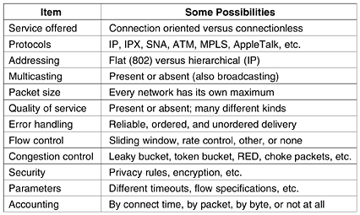
How Networks Differ

Slide 34
How Networks Can Be Connected?
Repeaters or Hubs (which layer?)
Bridges and Switches. (?)
Can translate protocol from Ethernet to FDDI or to 802.11. (minor protocol translation)
Routers (?)
A router that can handle multiple protocols is called a multiprotocol router.

Slide 35
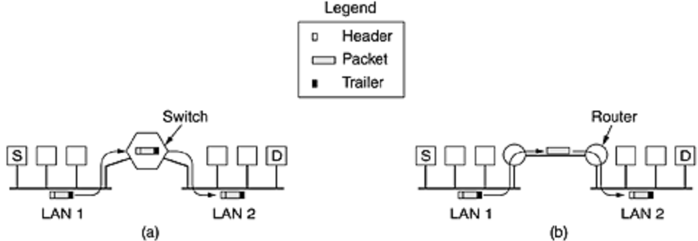
Switch vs Router
Switch only checks MAC address, but
Router checks the IP address.

Slide 36
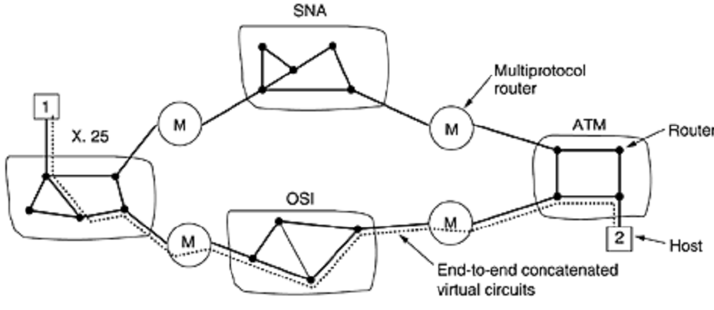
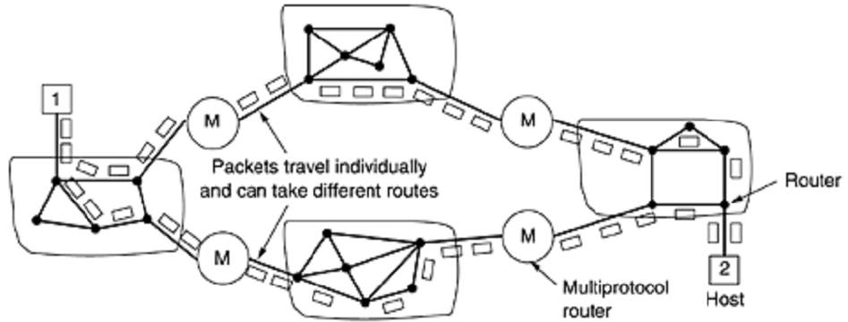

Slide 37
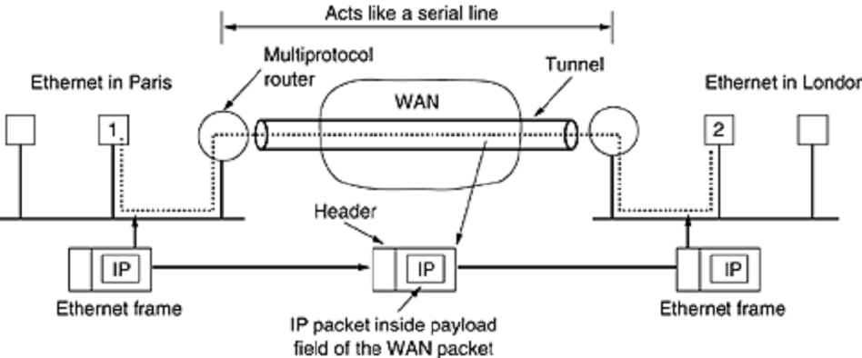
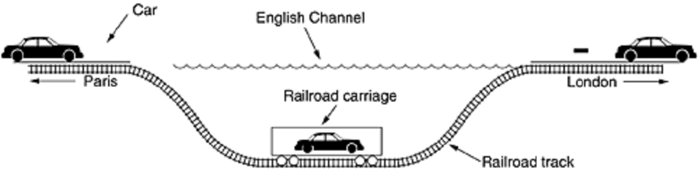
Tunneling

Slide 38
Fragmentation. Why?
1. Hardware (e.g., the size of an Ethernet frame).
2. Operating system (e.g., all buffers are 512 bytes).
3. Protocols (e.g., the number of bitsin the packet length field).
4. Compliance with some (inter)national standard.
5. Desire to reduce error-induced retransmissions to some level.
6. Desire to prevent one packet fromoccupying the channel too long.

Slide 39
IP Fragmentation
MTU = 2000
host
router
router
MTU = 1500
host
MTU = 4000
Every Network has Own Maximum Transmission Unit (MTU)
Largest IP datagram it can carry within its own packet frame
E.g., Ethernet is 1500 bytes
Don’t know MTUs of all intermediate networks in advance
IP Solution
When hit network with small MTU, fragment packets
Might get further fragmentation as proceed farther

Slide 40
Fragmentation Related Fields
Length
Length of IP fragment
Identification
To match up with other fragments
Fragment offset
Where this fragment lies in entire IP datagram
Flags
“More fragments” flag
“Don’t fragment” flag

Slide 41
Fragmentation Related Fields
Length
Length of IP fragment
Identification
To match up with other fragments
Fragment offset
Where this fragment lies in entire IP datagram
Flags
“More fragments” flag
“Don’t fragment” flag

Slide 42
IP Fragmentation Example #1
router
host
MTU = 4000
Length = 3820, M=0
IP
Header
IP
Data

Slide 43
IP Fragmentation Example #2
MTU = 2000
router
router
Length = 2000, M=1, Offset = 0
Length = 3820, M=0
IP
Header
IP
Data
IP
Header
IP
Data
1980 bytes
3800 bytes
Length = 1840, M=0, Offset = 1980
IP
Header
IP
Data
IP Header= 20 bytes
1820 bytes

Slide 44
IP Fragmentation Example #3
Length = 1500, M=1, Offset = 0
host
IP
Header
IP
Data
router
MTU = 1500
Length = 2000, M=1, Offset = 0
1480 bytes
IP
Header
IP
Data
Length = 520, M=1, Offset = 1480
IP
Header
IP
Data
1980 bytes
Length = 1500, M=1, Offset = 1980
IP
Header
IP
Data
500 bytes
Length = 1840, M=0, Offset = 1980
IP
Header
IP
Data
Length = 360, M=0, Offset = 3460
IP
Header
IP
Data
1480 bytes
1820 bytes
340 bytes

Slide 45
IP Reassembly
Fragments might arrive out-of-order
Don’t know how much memory required until receive final fragment
Some fragments may never arrive
After a while, give up entire process
Length = 1500, M=1, Offset = 0
IP
Header
IP
Data
Length = 520, M=1, Offset = 1480
IP
Header
IP
Data
Length = 1500, M=1, Offset = 1980
IP
Header
IP
Data
IP
Data
IP
Data
IP
Data
IP
Data
Length = 360, M=0, Offset = 3460
IP
Header
IP
Data

